Slide 1
Hardware Performance Monitor (HPM) - Nexys 4 DDR / MicroBlaze MCS
Gabriel Yeung
ELC 4312
Notes:
For my final project, I designed a Hardware Performance Monitor (HPM). The goal was to build a tool that acts like a monitoring tool for the processor, which allows us to see inside and measure code efficiency cycle-by-cycle without slowing down the software.

Slide 2
The Problem & Solution
The Problem: Standard software profilers add code overhead. They change the timing of what you are trying to measure.
The Solution: Non-Intrusive Hardware Monitoring.
Implementation: A custom peripheral that sits passively on the system bus and counts events in real-time.
Notes:
The problem with measuring software performance is that usually, you have to add more software to measure it, which slows everything down. My solution was to offload that job to hardware. I built a custom peripheral that sits on the system bus and counts clock cycles and memory accesses in the background, which is completely independent of the CPU.

Slide 3
The Architecture ("Snooping")
Core Architecture: Bus Snooping.
Control Path: MMIO Slot 5 (Used to Start/Stop/Reset).
Monitor Path: Wires connected to io_addr_strobe, io_read, io_write.
Why: Captures 100% of bus traffic, even if the CPU is talking to other peripherals.
Notes:
This part of the design is unique. I used a 'Bus Snooping' architecture. While the CPU uses the standard MMIO bus to send start and stop commands to the core (in Slot 5), the core has a second set of inputs, which are the 'Snoop' lines. These wires are physically connected to the main system bus strobes. This means the core watches every single instruction fetch and memory access the CPU makes, without the CPU even knowing it's being monitored.

Slide 4

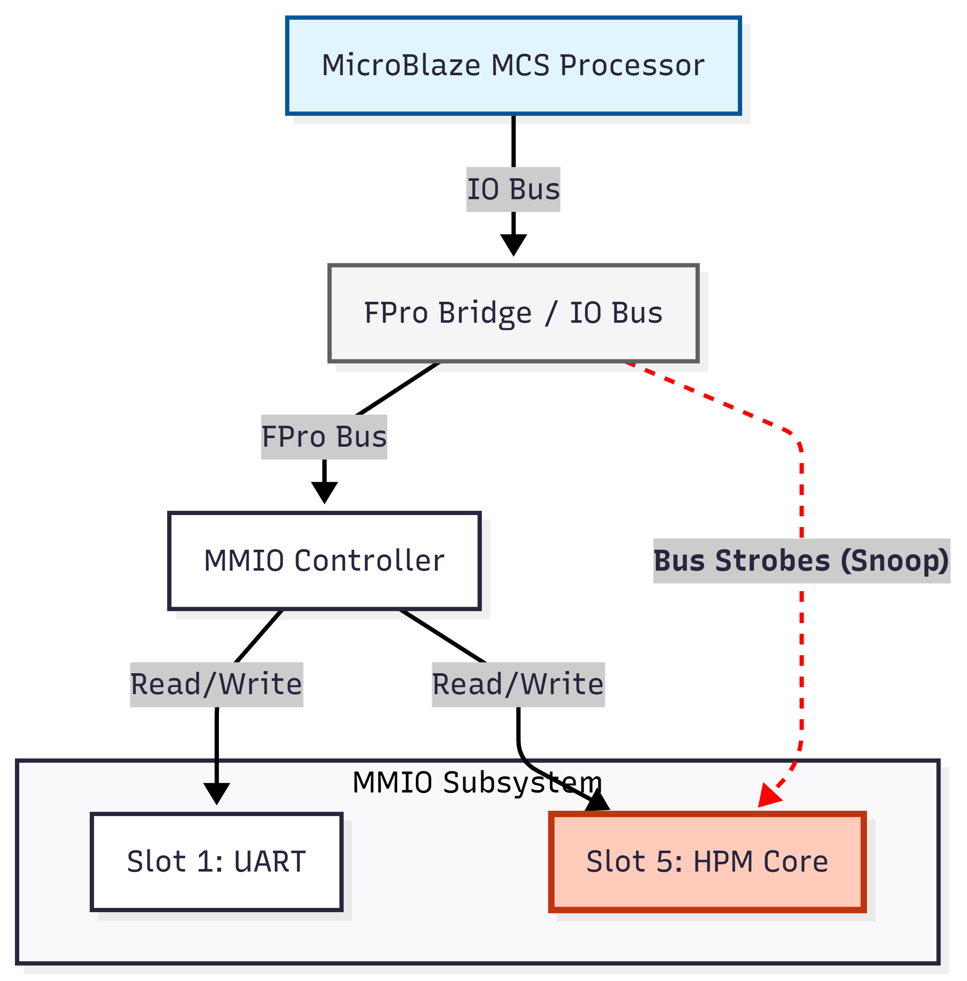

Slide 5
Experimental Results
Arithmetic Benchmark (1 Million Iterations):
  Time: 4.25 seconds
  Cycles per Operation: ~425
  Bottleneck: No Hardware Divider (FPU).
Memory Benchmark (10 Million Operations):
    Time: 1.31 seconds
    Cycles per Operation: ~13
    Advantage: Fast local Block RAM (BRAM).
Notes:
The results were interesting. I ran fairly intense stress test to compare math vs. memory. The Arithmetic test took over 4 seconds and it averaged 425 cycles per operation because the MicroBlaze lacks a hardware divider, so it has to use a slow software library to do math. The Memory test, despite doing 10 times the operations, finished in just 1.3 seconds. This proves that the system is 'Compute Bound’ and that the memory is very fast, but the math is slow.

Slide 6
Conclusion
Status: Fully functional & Deterministic.
  Key Insight: Hardware profiling shows the architectural bottlenecks not seen by software.
  Future Use: Can be used to optimize more critical real-time algorithms.
Notes:
In conclusion, the system is fully functional and deterministic. It successfully identified a hardware bottleneck in the ALU. This project proves that hardware-level profiling provides insights that you can’t really get from looking at C++ code alone.

Slide 7
Github Repo and YouTube Demo
GitHub Project Repository
HPM Video Demonstration

